Slide 1
Russian Strategy 2020 for Education - a European viewpoint Anton Dobart
Yaroslavl-Education Forum
April 2012

Slide 2
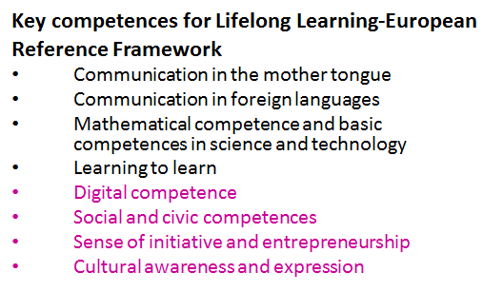
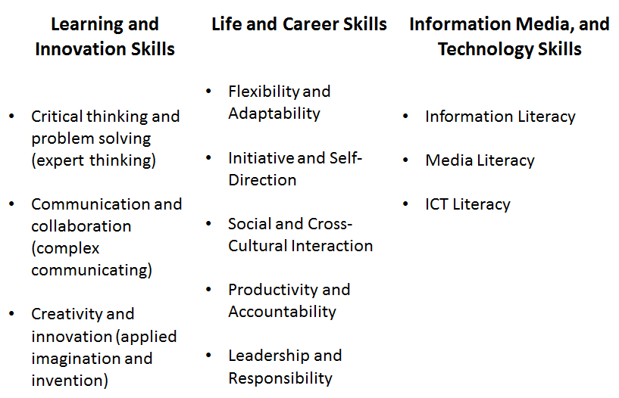
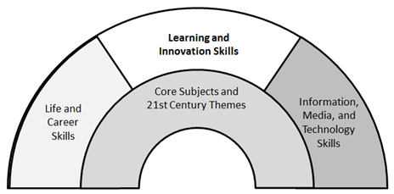
Competences and Skills for the 21st Century
Seven Survival Skills
Critical Thinking and Problem Solving
Collaboration Across Networks and Leading by Influence
Agility and Adaptability
Initiative and Entrepreneurialism
Effective Oral and Written Communication
Accessing and Analyzing Information
Curiosity and Imagination
Tony Wagner: The Global Achievement Gap

Slide 3
EU 2020 – A new European Strategy for Jobs and Growth
The new strategy will focus on the key areas where action is needed to boost Europe’s competitiveness and growth potential: knowledge and innovation, a greener economy, high employment and social inclusion
Three priorities should be the heart of Europe 2020:
Smart growth – developing an economy based on knowledge and innovation
Sustainable growth – promoting a more resource efficient, greener and more competitive economy
Inclusive growth – fostering a high-employment economy delivering economic, social and territorial cohesion
Flagship initiatives
European Digital Agenda
Industrial Policy for the globalised era
Innovation Union
Youth on the Move
New skills for new jobs
Platform against poverty
Resource efficient Europe will be delivered through a number of different initiatives in the 2010 Commission Work Programm
Notes:
Headline targets:
Aiming to bring 75% the employment rate for woman and men aged 20-64
Improving the conditions for research and development, combined public and private investment levels in this sector to 3% of GDP
Reducing greenhouse gas emissions by 20% compared to 1990 levels; increasing renewables in final consumption to 20%, moving towards a 20% increase in energy efficiency
Improving education levelx, in particular by aiming to reduce school drop-out rates and by increasing the share of the population having completed tertiary or equivalent education
Promoting social inclusion, in particular through the reduction of poverty

Slide 4
Strategic Framework E&T 2020
Make lifelong learning and mobilty a reality
Lifelong learning strategies, incl. guidance
EQF/validation/learning outcomes
Expanding Learning Mobility
Improve quality and efficiency
Language competences
Professional development of teachers and trainers
Governance and funding
HE Modernisation
VET quality assurance
Basic skills
New skills for new jobs
Promote equity and active citizenship
Early school leaver
Pre-primary education
Migrants
Learners with special needs
Promote innovation and creativity, including entrepreneurship
Transversal key competences
Innovation friendly institutions
Partnership

Slide 5
Educational Trends and Settings
Professionalism
Students‘ identities and destinies will be fluid;
Customized learning
Education will be user-led, teach less learn more
Education will be lifelong, formal and informal;
Schools will be culturally heterogeneous;
Schooling as response to social and cultural diversity
Collaborative group learning
Roles will be blurred and overlapping;
Education will be unconstrained by time and place;
Availability of diverse knowledge sources
Schools and teachers will be embedded in complex, interconnected networks; and,
Assessment of the conceptual understanding
Teachers now and in the future must know how to:
Teach the Googled learner, who has grown up on virtual-reality games and can find out almost everything with a few taps of the finger;
Work with a student body that’s increasingly diverse (by 2030, 40 percent of students or more will be second-language learners);
Prepare kids to compete for jobs in a global marketplace where communication, collaboration, critical thinking, and creative problem-solving are the “new basics”;
Help students monitor their own learning using sophisticated tools to assess whether they meet high academic standards, and fine-tuning instruction when they don’t; and
Connect teaching to the needs of communities as economic churn creates family and societal instability, pushing schools to integrate health and social services with academic learning.
Source: Teaching 2030: The Education Students Need and Deserve, by Barnett

Slide 6
The Fourth Way
National Vision
Government
Steering and
Support
Learning
and
Results
Public
Engagement
Professional
Involvement
Source: http://education.alberta.ca/media/6451052/the_fourth_way_of_leadership_and_change-andy_hargreaves.pdf

Slide 7
Five Pillars of Purpose and Partnership
An Inspiring and Inclusive Vision
Public Engagement
No Achievement Without Investment
Corporate Educational Responsibility
Students as Partners in Change
Source: http://education.alberta.ca/media/6451052/the_fourth_way_of_leadership_and_change-andy_hargreaves.pdf

Slide 8
Thank you for your attention!

